Slide 1

House Price Prediction
An End-to-End Exploration of Predictive Modeling & Market Segmentation in India
Presenter: MODASSIR QUAISAR
Analyzing 12,000 Property Records Across 5 Major Metro Hubs

Slide 2

Executive Summary & High-Level Scope
The Problem Space: Real estate valuation is highly multi-dimensional, influenced by layout, city location, and city-center proximity.
"Our goal is simple: avoid messy data and build a stable, modular workspace to get a complete view of the market's layout."
Our Multi-Phase Approach:
Data Cleaning: Enforcing physical real-world logic rules.
Classification: Categorizing neighborhood tiers.
Regression: Maximizing price prediction accuracy.
Clustering: Socioeconomic market grouping.

Slide 3

The Analytical Toolkit
Linear Regression
Multi-Linear Reg.
Decision Tree
Establishing the single-feature baseline for spatial valuation.
Integrating all structural and locational variables for accuracy.
Building hierarchical logical splits for categorical tiering.
Logistic Regression
KNN
k-means
Defining linear boundaries for multi-class classification.
Utilizing neighbor proximity for spatial neighborhood grouping.
Discovering latent property archetypes through clustering.

Slide 4

Dataset Characteristics & Scope
12k
Comprehensive Feature Space
5 Economic Hubs: Mumbai, Bangalore, Hyderabad, Pune, Nagpur.
21 Attributes: Structural, Geographical, and Social metrics.
Risk Indices: Local crime index and proximity to security infra.
Observations

Slide 5

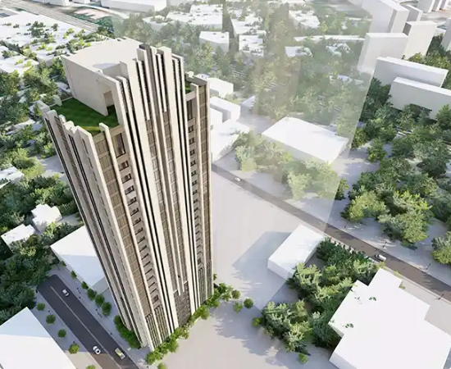
Data Engineering & Integrity
Physical Guards: Validated that Carpet Area ≤ Super-Built Area for every record.
Vertical Limits: Cross-verified that Unit Floor ≤ Total Floors of the structure.
Outlier Preservation: Intentionally maintained 545 luxury points to ensure accurate elite market modeling.

Slide 6
Preprocessing & Scalability
One-Hot Encoding: Transformed nominal cities and furnishing status into binary indicator variables.
Standard Scaling: Applied Z-score standardization ($\mu=0, \sigma=1$) to prevent feature dominance.
Evaluation Split: Locked 80/20 train-test partitioning for rigorous validation.

Slide 7
Phase 1: Locality Classification
Algorithm Configuration | Testing Accuracy | Macro F1-Score | Strategic Assessment
Logistic Regression (L2) | 97.00% | 0.97 | Optimal Linear Boundaries
Decision Tree Classifier | 91.00% | 0.91 | Highly Interpretable Splits
K-Nearest Neighbors (KNN) | 76.42% | 0.76 | Impacted by Spatial Noise

Slide 8

Insight: Linear Separability
Why Logistic Regression Won
The Challenge for KNN
The 97% accuracy achieved by Logistic Regression demonstrates that Indian property tiers (Budget, Mid, Premium) are highly linearly separable once price-to-size ratios are normalized.
Multi-dimensional distance noise in high-density metros reduced KNN's effectiveness, as similar prices did not always correlate to similar geographic proximity.

Slide 9
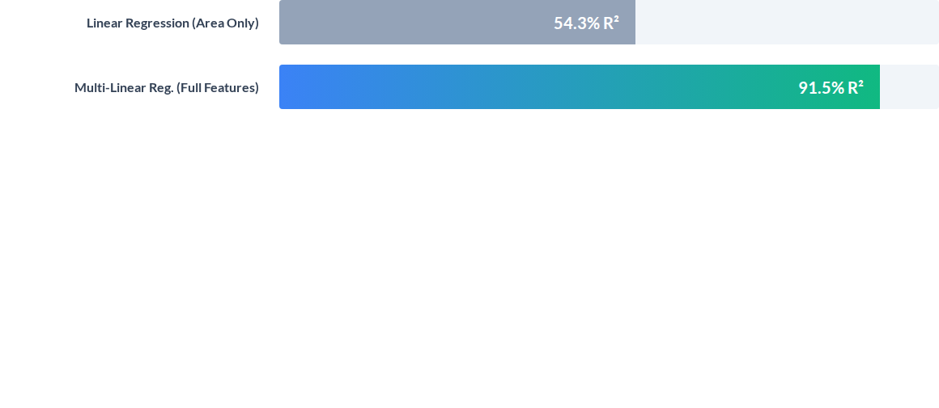

Phase 2: Continuous Price Prediction
Transitioning to Multi-Linear Regression captures 37.2% more variance and cuts average prediction errors in half.

Slide 10

Regression Performance Drivers
Locational Alpha: Market price is heavily dictated by city-specific indicator variables.
Structural Age: Property age provides a significant negative weight in the Multi-Linear equation.
Connectivity: Metro proximity scores add high predictive value in Tier 1 cities.

Slide 11

Phase 3: Market Segmentation
Unsupervised Discovery (k-means)
By mapping Euclidean distance across price, size, and layout, k-means successfully isolated latent socioeconomic property brackets.
Discovery: Natural grouping without target labels.
Profiling: Segments differentiate based on socioeconomic density.

Slide 12
Identified Property Archetypes
Cluster Archetype | Avg. Super Area | Avg. Market Price | Avg. Distance to Center
Luxury Elite | 1,677 sqft | ₹2.14 Crores | 10.6 km
Mid-Market Core | 1,082 sqft | ₹1.10 Crores | 11.2 km
Suburban Budget | 741 sqft | ₹57.36 Lakhs | 18.0 km

Slide 13
Conclusions & Operationalization
Automated Appraisal
Precision Targeting
The Roadmap
Deploying Multi-Linear models for objective price validation in banking.
Using k-means clusters to tailor developer marketing toward 'Elite' buyer personas.
Future integration of real-time interest rate sensitivity and localized sentiment indices.

Slide 14

Thank You
"Leveraging multi-dimensional machine learning architectures to unlock transparency, certainty, and data-driven intelligence across the Indian housing market."
HOUSE PRICE PREDICTION — INTERNSHIP PROJECT CONCLUSION
Presented by: MODASSIR QUAISAR

Slide 15



Image Sources
https://talatiandpartners.com/wp-content/uploads/2022/12/mobileslider360X270-luxury-residences-copy-2.webp
Source: talatiandpartners.com
https://static.vecteezy.com/system/resources/previews/078/765/353/non_2x/abstract-technology-screen-background-with-circular-data-visualization-futuristic-digital-analytics-charts-with-glowing-interface-elements-big-data-monitoring-dashboard-concept-vector.jpg
Source: www.vecteezy.com
https://boraberan.wordpress.com/wp-content/uploads/2015/12/particles.gif
Source: boraberan.wordpress.com

